Slide 1
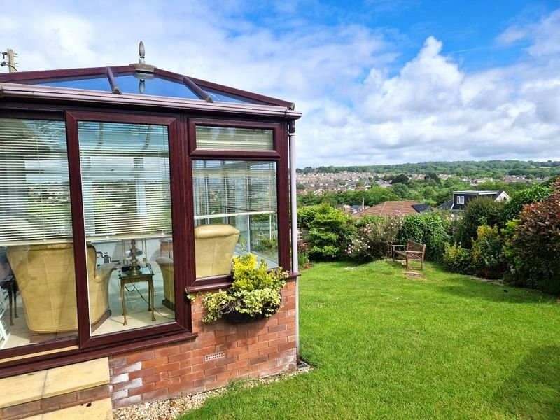
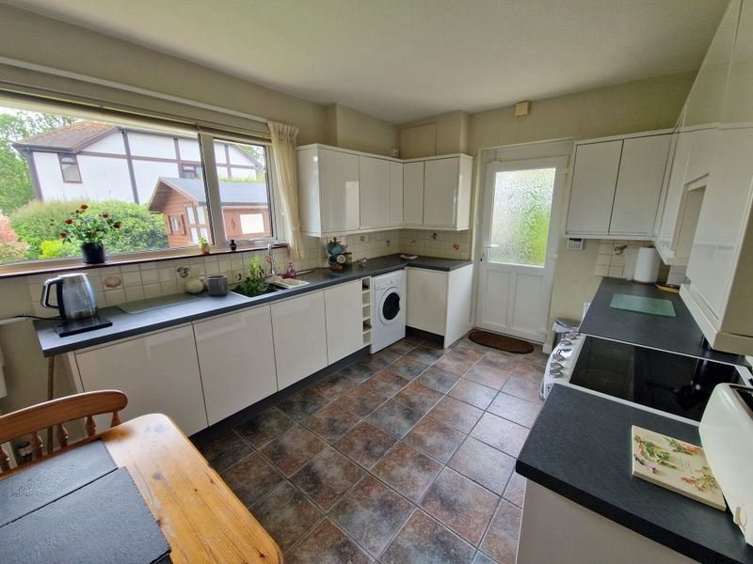
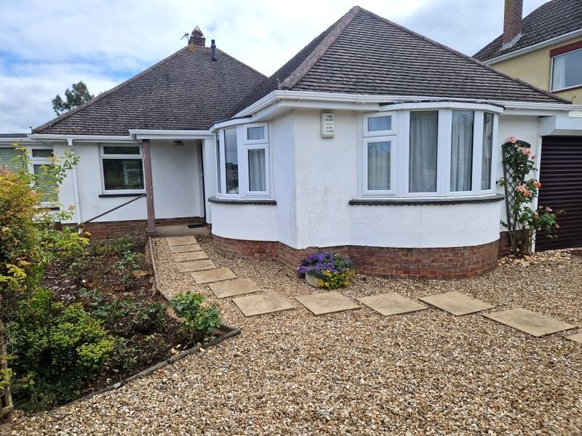
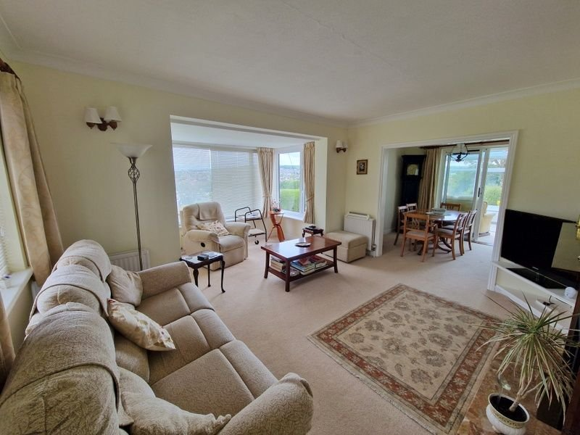
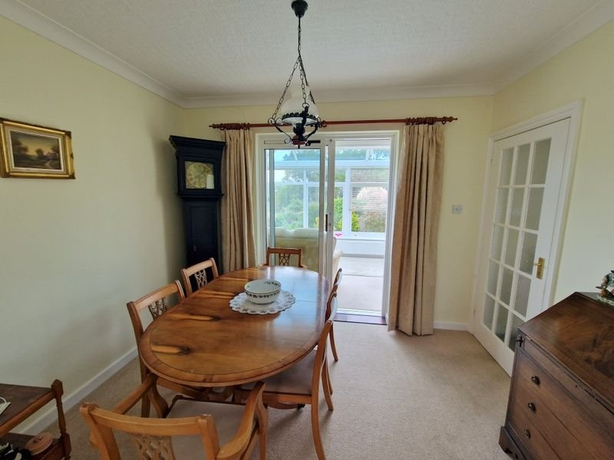
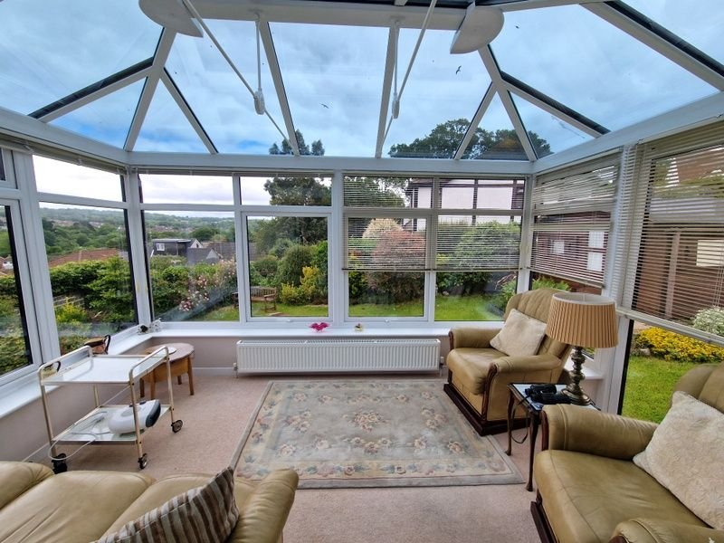
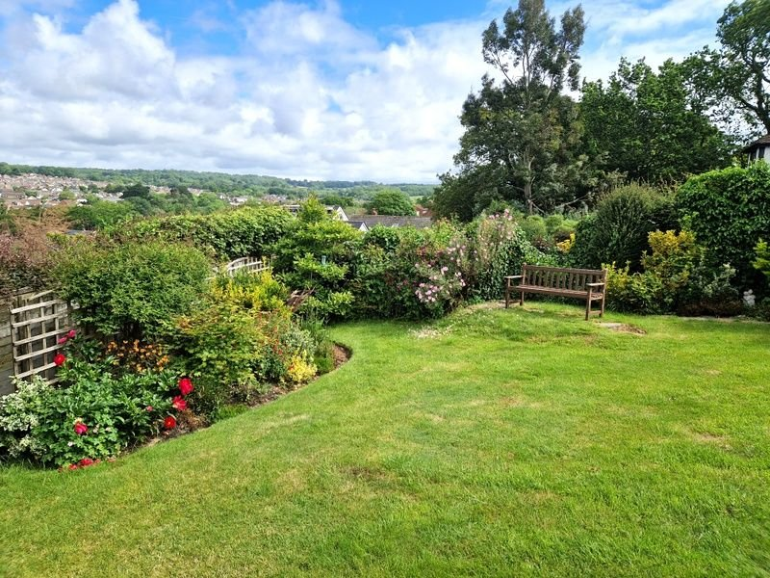
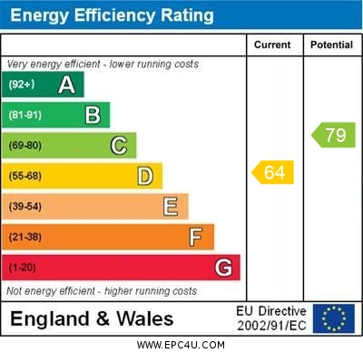
www.pennys.net
Hillcrest, 5 Freelands Close, Exmouth, EX8 4AE
GUIDE PRICE £475,000
TENURE Freehold
A Beautifully Presented Detached Bungalow With Open Views Across The Town And Enjoying Enviable Cul-De-Sac Location
Reception Hall * Spacious Dual Aspect Lounge * Dining Room * Double Glazed Conservatory * Modern Kitchen/Breakfast Room * Two Double Bedrooms * Modern Shower Room/Wc * Well Tended Gardens * Decorative Stone Driveway * Garage * Gas Central Heating * Double Glazed Windows * Viewing Recommended * No Ongoing Chain
Pennys Estate Agents Limited for themselves and for the vendor of this property whose agents they are give notice that:- (1) These particulars do not constitute any part of an offer or a contract. (2) All statements contained in these particulars are made without responsibility on the part of Pennys Estate Agents Limited. (3) None of the statements contained in these particulars are to be relied upon as a statement or representation of fact. (4) Any intending purchaser must satisfy himself/herself by inspection or otherwise as to the correctness of each of the statements contained in these particulars. (5) The vendor does not make or give and neither do Pennys Estate Agents Limited nor any person in their employment has any authority to make or give any representation or warranty whatever in relation to this property.
PENNYS ESTATE AGENTS
2 Rolle House, Rolle Street, Exmouth, Devon, EX8 2SN
Tel: 01395 264111 EMail: help@pennys.net

Slide 2
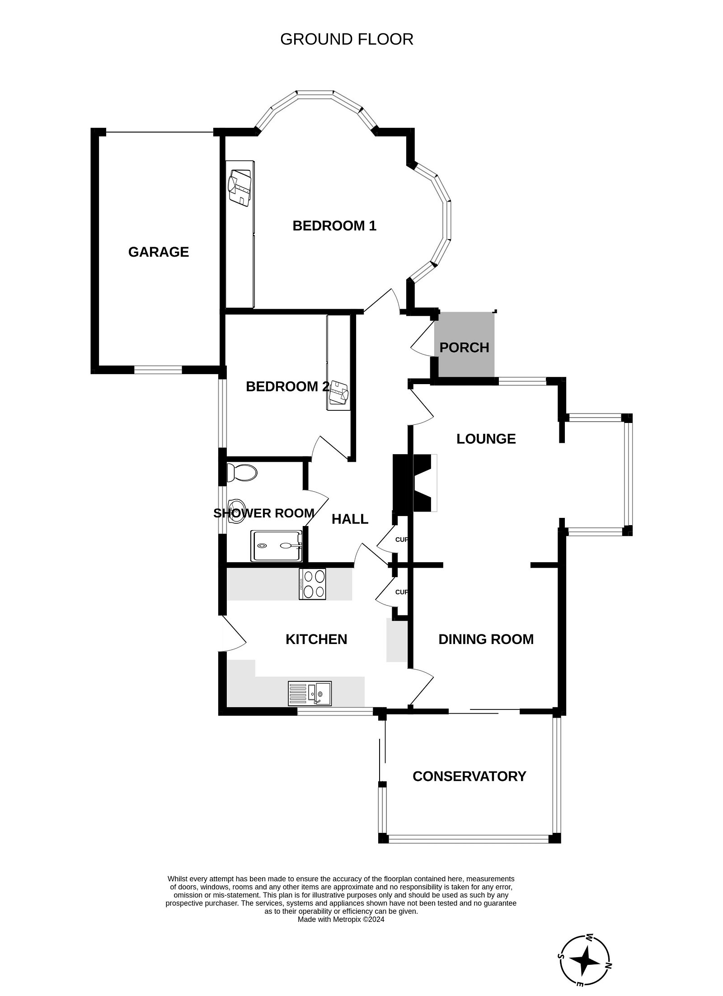
Hillcrest, 5 Freelands Close, Exmouth, EX8 4AE
THE ACCOMMODATION COMPRISES: Pillared entrance canopy with courtesy light, wood effect double glazed front door with pattern window inset giving access to:
RECEPTION HALL: Radiator, access to loft space (gas boiler in roof space), coats cupboard – two fitted to storage cupboards, coved ceiling, glazed panelled door to:
LOUNGE: 4.85m x 4.39m (15'11" x 14'5") A bright dual aspect room with measurement into double glazed square bay window overlooking the front elevation with additional double glazed window to front elevation with excellent open views across the town. Wooden fire surround housing living flame coal-effect gas fire with marble hearth and matching insert. Three radiators, TV point, wall lighting, opening to:
DINING ROOM: 3.2m x 2.44m (10'6" x 8'0") With radiator, coved ceiling, sliding double glazed patio doors to:
CONSERVATORY: 3.96m x 2.95m (13'0" x 9'8") A fine addition to the accommodation with uPVC double glazed windows under a glass reflective roof and gaining wonderful open views across the town. Radiator, power connected, TV point, sliding double glazed patio doors opening onto the rear garden.
KITCHEN/BREAKFAST ROOM: 4.52m x 2.92m (14'10" x 9'7") Accessed from both the reception hall and the dining room. A stylish kitchen fitted with white units with a range of patterned worktops with inset one and a quarter bowl sink unit with mixer tap. Cupboards, drawer units, integrated dishwasher, plumbing for automatic washing machine and appliance spaces beneath worktops with tiled patterned surrounds. Wall mounted cupboards, electric cooker point, linen cupboard with slatted shelving, wall recess with fitted worktop and cupboard beneath with shelving over. Double glazed window overlooking the rear garden, tiled flooring, double glazed door with patterned glass giving access to the rear garden.
BEDROOM 1: 4.57m x 4.24m (15'0" x 13'11") A bright room with measurements into two uPVC double glazed bay windows overlooking the front and side elevations. Built-in wardrobes with clothes rail and shelf. Two radiators. Coved ceiling.
BEDROOM 2: 3.12m x 2.82m (10'3" x 9'3") With built-in floor to ceiling mirror fronted wardrobes with sliding doors, radiator, uVPC double glazed window overlooking the garden.
SHOWER ROOM/WC: 2.24m x 1.68m (7'4" x 5'6") Stylishly fitted with a modern suite comprising double width shower cubicle with sliding shower splash screen door, vanity style wash hand basin with cupboards, cabinet beneath, adjoining display surface with WC with push button flush beneath, fully tiled walls with colour coordinated tiled flooring, radiator, fitted wall mirror, ceiling extractor fan, uPVC double glazed window with patterned glass.
OUTSIDE: The property is located towards the head of a sought after cul-de-sac and is approached via double wooden gates with decorative stone driveway giving access to the garage. The front garden comprises a decorative stone garden area with raised, well stocked flower, shrub and rose beds with patio stones leading to the bungalow. A side pathway leads through to the rear garden. The rear garden is a lovely feature of the property offering an array of colour with well stocked flower and shrub beds, extensively laid to lawn with patio sun terrace which is ideal for outside entertaining. From the garden there are lovely views across the town towards the estuary and coastline beyond.
There is a substantial SUMMERHOUSE: 3.66m x 3.61m (12'0" x 11'10") Power and light connected. Double glazed windows, decorative stoned side garden and patio pathway and gate giving access back around to the front of the property. Outside lighting and outside cold water tap.
GARAGE: 5.16m x 2.79m (16'11" x 9'2") With electric roller up and over door, power and light connected, double glazed window with patterned glass.
FLOOR PLAN:

